Slide 1
TABLE OF CONTENTS
1. Shipping Wise Profit
2. Year Wise Profit
3. City Wise Profit
4. Category & Discount Wise Profit
5. Customer Buying Behavior
6. Region & Category Wise Sales
7. Weekend & Weekdays Wise Profit

Slide 2
Shipping Wise Profit – Created By Sakshi
Shipping Modes | Sum of Profit
Standard Class | 164089
Second Class | 57447
First Class | 48970
Same Day | 15892
Grand Total | 286397

Slide 3
Year Wise Profit – Created By Priti
Years | Sum of Profit
2014 | 49544
2015 | 61619
2016 | 81795
2017 | 93439
Grand Total | 286397

Slide 4
City Wise Profit – Created By Mahesh
City Names | Sum of Profit
New York City | 62037
Los Angeles | 30441
Seattle | 29156
San Francisco | 17507
Detroit | 13182
Grand Total | 152323

Slide 5
Category & Discount Wise Profit – Created By Harsh
Category | Sum of Discount | Sum of Profit
Technology | 244 | 145455
Office Supplies | 948 | 122491
Furniture | 369 | 18451
Grand Total | 1561 | 286397

Slide 6
Region & Category Wise Sales – Created By Sushmita
Region | Sum of Sales
Central | 501240
Technology | 170416
Office Supplies | 167026
Furniture | 163797
East | 678781
Technology | 264974
Furniture | 208291
Office Supplies | 205516
South | 391722
Technology | 148772
Office Supplies | 125651
Furniture | 117299
West | 725458
Furniture | 252613
Technology | 251992
Office Supplies | 220853
Grand Total | 2297201

Slide 7
Customer Buying Behavior– Created By Saurabh
Top 10 Customer | Weekday | Weekend | Grand Total
Sean Miller | 24517 | 526 | 25043
Tamara Chand | 100 | 18952 | 19052
Raymond Buch | 15057 | 60 | 15117
Tom Ashbrook | 879 | 13716 | 14596
Adrian Barton | 1565 | 12908 | 14474
Ken Lonsdale | 11708 | 2467 | 14175
Sanjit Chand | 12836 | 1306 | 14142
Hunter Lopez | 12873 |  | 12873
Sanjit Engle | 11231 | 978 | 12209
Christopher Conant | 12129 |  | 12129
Grand Total | 102896 | 50915 | 153811

Slide 8
Weekend & Weekdays Wise Profit – Created By Chandradip
Weekend & Weekday | Sum of Profit
Weekday | 187990
Weekend | 98407
Grand Total | 286397

Slide 9
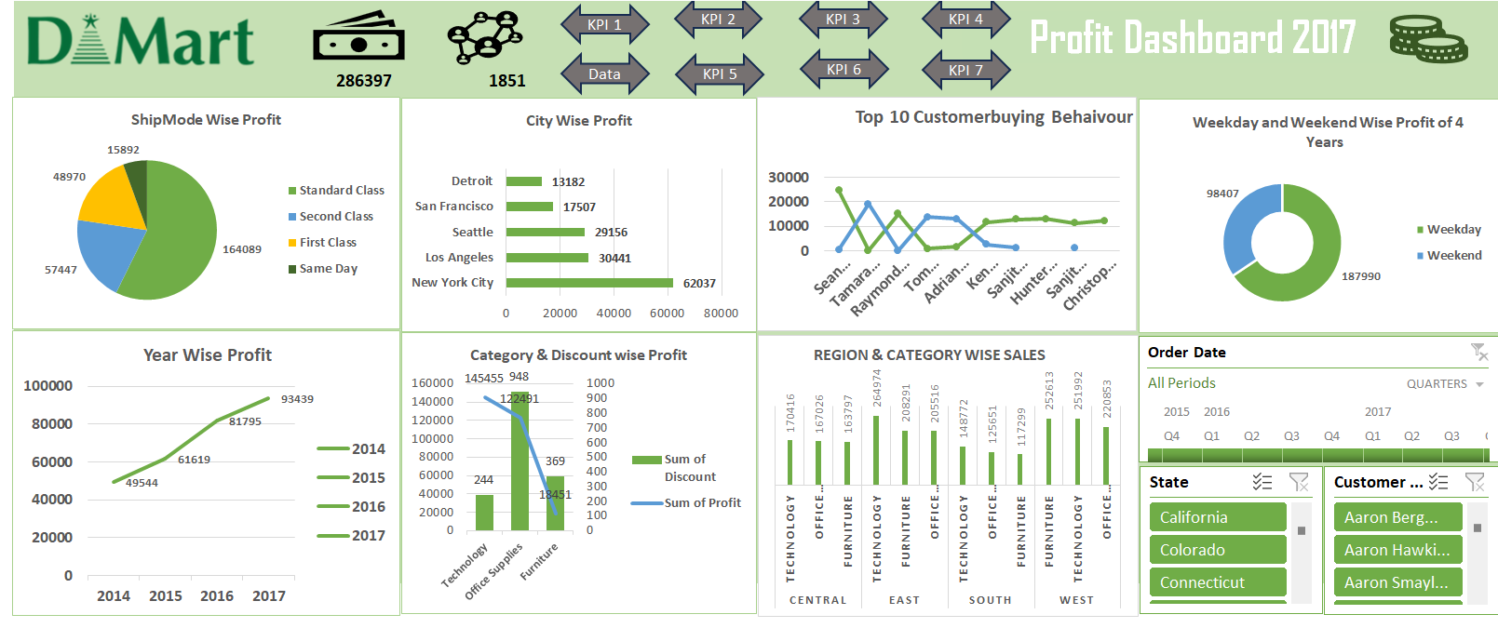
Final Dashboard

